Slide 1

COURSE
NOTES:
DESCRIPTIVE
STATISTICS

Slide 2
Types
of
data
Types of data
Categorical
Numerical
Categorical data represents groups or categories.
Examples:
Discrete
Continuous
1. Car brands: Audi, BMW and Mercedes.
Numerical data represents numbers. It is divided into two groups: discrete and continuous. Discrete data can be usually counted in a finite matter, while continuous is infinite and impossible to count.
2. Answers to yes/no questions: yes and no
Examples:
Discrete: # classes you want to have, exam score
Continuous: weight, height

Slide 3
Levels
of
measurement
Levels of measurement
Qualitative
Quantitative
Nominal
Ordinal
Interval
Ratio
There are two qualitative levels: nominal and ordinal. The
nominal level represents categories that cannot be put in any order, while ordinal represents categories that can be ordered.
There are two quantitative levels: interval and ratio. They
both represent “numbers”, however, ratios have a true zero, while intervals don’t.
Examples:
Interval: degrees Celsius and Fahrenheit
Ratio: degrees Kelvin, length
Examples:
Nominal: four seasons (winter, spring, summer, autumn) Ordinal: rating your meal (disgusting, unappetizing, neutral, tasty, and delicious)

Slide 4






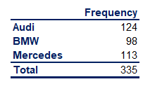
Graphs
and
tables that
represent categorical
variables
Frequency
distribution tables
Bar charts
Pie charts
Pareto diagrams
Sales
150
Sales
Merced
es
34%
150
100%
80%
60%
40%
20%
0%
124
Audi
37%
124
100
98
113
100
113
98
Frequency
Frequency
50
50
0
Audi BMW
Mercedes
BMW
29%
0
Audi
Mercedes BMW
Frequency distribution tables
Bar charts are very common.
Each bar represents a category. On the y-axis we have the absolute frequency.
Pie charts
are used when
we
an
The
Pareto diagram is a
special
show
the
category
and
its
want to see the share of
type of bar chart where the
corresponding
frequency.
absolute
item as a part of the total.
Market share is almost always represented with a pie chart.
categories
are
shown
in
descending order of frequency,
and a separate curve shows the cumulative frequency.

Slide 5

Graphs and tables
that represent
categorical variables.
Excel formulas
Frequency
distribution tables
Bar charts
Pie charts
Pareto diagrams
Sales
150
Sales
Merced
es
34%
150
100%
80%
60%
40%
20%
0%
124
Audi
37%
124
100
98
113
100
113
98
Frequency
Frequency
50
50
0
Audi BMW
Mercedes
BMW
29%
0
Audi
Mercedes BMW
In Excel, we can either hard
code the frequencies or count them with a count function. This will come up later on.
Total formula: =SUM()
Bar
charts
are
also
called
Pie charts
are created
in the
Next slide.
clustered
column charts
in
following way:
Choose your data, Insert -> Charts -> Pie chart
Excel. Choose your data, Insert
-> Charts -> Clustered column or Bar chart.

Slide 6
Pareto
diagrams
in Excel
Creating Pareto diagrams in Excel:
1.
Order the data in your frequency distribution table in
descending order.
Create a bar chart.
Add a column in your frequency distribution table that measures the cumulative frequency.
Select the plot area of the chart in Excel and Right click.
Choose Select series.
Click Add
Series name doesn’t matter. You can put ‘Line’
For Series values choose the cells that refer to the cumulative frequency.
Click OK. You should see two side-by-side bars.
Select the plot area of the chart and Right click.
Choose Change Chart Type.
Select Combo.
Choose the type of representation from the dropdown
Sales
2.
3.
150
100%
90%
124
80%
4.
113
70%
100
98
5.
6.
7.
8.
60%
Frequency
50%
40%
50
30%
20%
9.
10.
11.
12.
13.
10%
0
Audi
Mercedes
BMW
0%
list.
Your
initial categories should
be ‘ Clustered
Column’. Change the second series, that you called
‘Line’, to ‘Line’.
Done.
14.

Slide 7
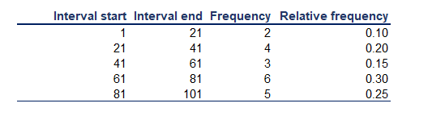

Numerical
variables.
Frequency distribution table and histogram
Frequency distribution tables for numerical variables are different than
the ones for categorical. Usually, they are divided into intervals of equal
(or unequal) length. The tables show the interval, the absolute
frequency and sometimes it is useful to also include the relative
cumulative) frequencies.
(and
The interval width is calculated using the following formula:
Creating the frequency distribution table in Excel:
1.
2.
3.
4.
5.
6.
7.
Decide on the number of intervals you would like to use.
Find the interval width (using a the formula above).
Start your 1st interval at the lowest value in your dataset.
Finish your 1st interval at the lowest value + the interval width. ( = start_interval_cell + interval_width_cell )
Start your 2nd interval where the 1st stops (that's a formula as well - just make the starting cell of interval 2 = the ending of interval 1) Continue in this way until you have created the desired number of intervals.
Count the absolute frequencies using the following COUNTIF formula:
=COUNTIF(dataset_range,">=“&interval start) -COUNTIF(dataset_range,">“&interval end).
In order to calculate the relative frequencies, use the following formula: = absolute_frequency_cell / number_of_observations
In order to calculate the cumulative frequencies:
8.
9.
i.
The first cumulative frequency is equal to the relative frequency
ii. Each consequitive cumulative frequency = previous cumulative frequency + the respective relative frequency

Slide 8
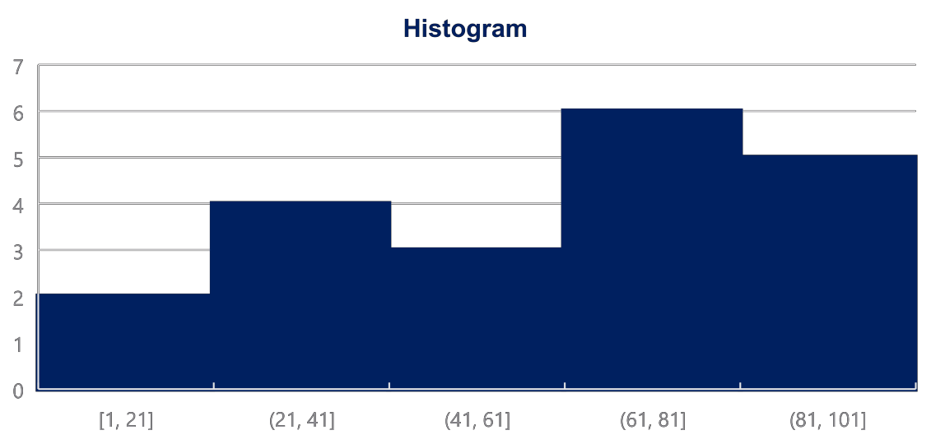
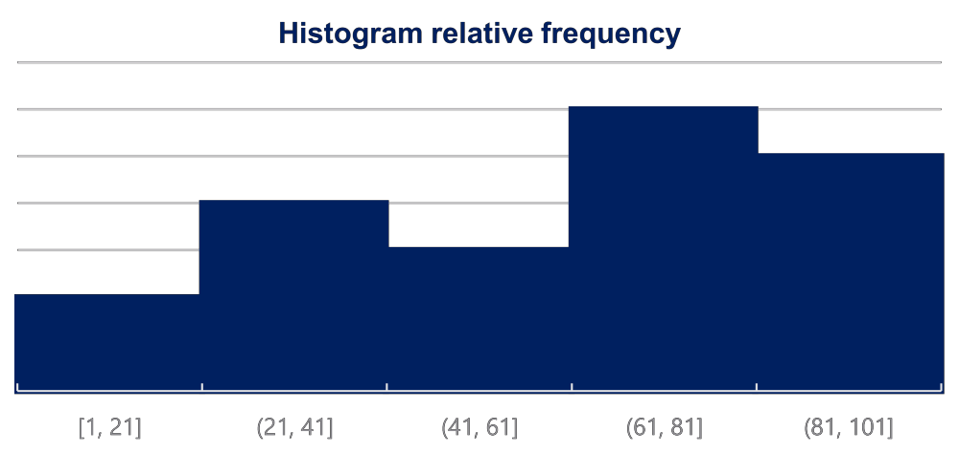
Numerical
variables.
Frequency
distribution table and histogram
Histograms are the one of the most common ways to represent
numerical data. Each bar has width equal to the width of the interval. The bars are touching as there is continuation between intervals: where one ends -> the other begins.
Creating a histogram in Excel:
0.30
1.
2.
3.
Choose your data
Insert -> Charts -> Histogram
To change the number of bins (intervals):
0.25
0.20
0.15
1.
2.
3.
Select the x-axis
Click Chart Tools -> Format -> Axis options
You can select the bin width (interval width), number of bins, etc.
0.10

Slide 9
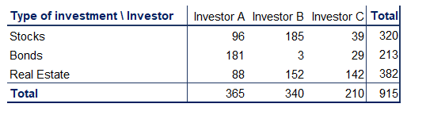
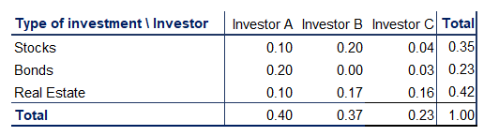
Graphs
and
tables
for
relationships between variables. Cross tables
Cross tables (or contingency tables) are used to represent categorical variables. One set
of categories is labeling the rows and another is labeling the columns. We then fill in the table with the applicable data. It is a good idea to calculate the totals. Sometimes, these tables are constructed with the relative frequencies as shown in the table below.
Side-by-side bar chart
A common way to represent the data from
side-by-side bar chart.
a
cross
table
is
by
using
a
200
180
160
140
120
100
80
60
40
20
0
Creating a side-by-side chart in Excel:
1.
2.
Choose your data
Insert -> Charts -> Clustered Column
Selecting more than one series ( groups
of
data ) will
automatically
prompt Excel to create a side-by-side bar (column) chart.
Investor A
Investor B
Investor C
Stocks
Bonds
Real Estate

Slide 10
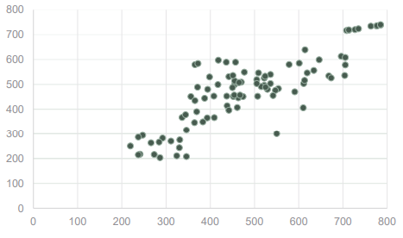
Graphs
and
tables
for
relationships between variables. Scatter plots
When we want to represent two numerical variables on the same graph, we usually use
a scatter plot. Scatter plots are useful especially later on, when we talk about regression analysis, as they help us detect patterns (linearity, homoscedasticity).
Scatter plots usually represent lots and lots of data. Typically,
single observations, but rather in the structure of the dataset.
we
are
not
interested
in
Creating a scatter plot in Excel:
1.
2.
Choose the two datasets you want to plot.
Insert -> Charts -> Scatter
26
25.5
25
A scatter plot that looks in the following way (down) represents data that
a pattern. Completely vertical ‘forms’ show no association.
doesn’t have
24.5
24
23.5
Conversely, the plot above shows a linear pattern, meaning that the observations move
together.
23
22.5
22
21.5
0
20
40
60
80
100
120
140
160
180

Slide 11

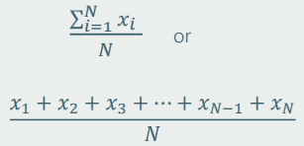
Mean,
median,
mode
Mean
The mean is the most widely spread measure of central tendency. It is the simple average of the dataset.
Note: easily affected by outliers
The formula to calculate the mean is:
In Excel, the mean is calculated by: =AVERAGE()
Median
The median is the midpoint of the ordered dataset. It is not as popular as the mean, but is often used in academia and data science. That is since it is not affected by outliers.
In an ordered dataset, the median is
the number at position
If this position is not a whole number, it, the median is the simple average of the two numbers at positions closest to the calculated value.
In Excel, the median is calculated by:
=MEDIAN()
Mode
The mode is the value that occurs most often. A dataset can have 0 modes, 1 mode or multiple modes.
The mode is calculated simply by finding the value with the highest frequency.
In Excel, the mode is calculated by:
=MODE.SNGL() -> returns one mode
=MODE.MULT() -> returns an array
with the modes. It is used when we
have more than 1 mode.

Slide 12
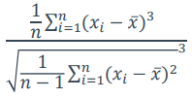
Skewness
Skewness is a measure of asymmetry that indicates whether
the observations in a dataset are concentrated on one side.
Right (positive) skewness looks like the one in the graph. It
means that the outliers are to the right (long tail to the right).
Left (negative) skewness means that the outliers are to the left.
Usually, you will use software to calculate skewness.
Median Mean
Mode
Calculating skewness in Excel:
Formula to calculate skewness:
=SKEW()

Slide 13
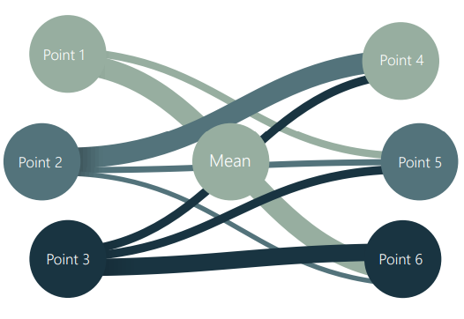
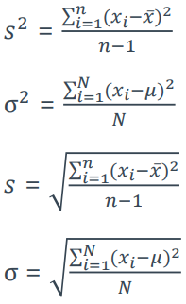
Variance
and
standard deviation
Variance and standard deviation measure the dispersion of a
set of data points around its mean value.
There are different formulas for population and sample
variance & standard deviation. This is due to the fact that the sample formulas are the unbiased estimators of the population formulas. More on the mathematics behind it.
Sample variance formula:
Population variance formula:
Calculating variance in Excel:
Sample standard deviation formula:
Sample variance:
=VAR.S()
Population variance:
=VAR.P()
Sample standard deviation: = STDEV.S()
Population standard deviation: =STDEV.P()
Population standard deviation formula:

Slide 14
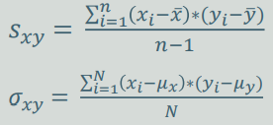


Covariance
and
correlation
Covariance
Correlation
Correlation is a measure of the joint variability of two variables. Unlike covariance, correlation could be thought of as a standardized measure. It takes on values between -1 and 1, thus it is easy for us to interpret the result.
➢ A correlation of 1, known as perfect positive correlation, means that one variable is perfectly explained by the other.
➢ A correlation of 0 means that the variables are independent.
➢ A correlation of -1, known as perfect negative correlation, means that one variable is explaining the other one perfectly, but they move in opposite directions.
In Excel, correlation is calculated by:
=CORREL()
Covariance is a measure of the joint variability of two variables.
➢ A positive covariance means that the two variables move together.
➢ A covariance of 0 means that the two variables are
independent.
➢ A negative covariance means that the two variables move in opposite directions.
Covariance can take on values from -∞ to +∞ . This is a problem as it is very hard to put such numbers into perspective.
^{Sample covariance formula:}
^{Population covariance formula:}
In Excel, the covariance is calculated by:
Sample covariance: =COV ARIANCE .S() Population covariance: =COV ARIANCE .P()
Sample correlation formula:
Population correlation formula:

